Slide 1
OSI Model

Slide 2
Example 4
Figure 3 shows two computers communicating via the Internet. The sending computer is running three processes at this time with port addresses a, b, and c. The receiving computer is running two processes at this time with port addresses j and k. Process a in the sending computer needs to communicate with process j in the receiving computer. Note that although physical addresses change from hop to hop, logical and port addresses remain the same from the source to destination.

Slide 3
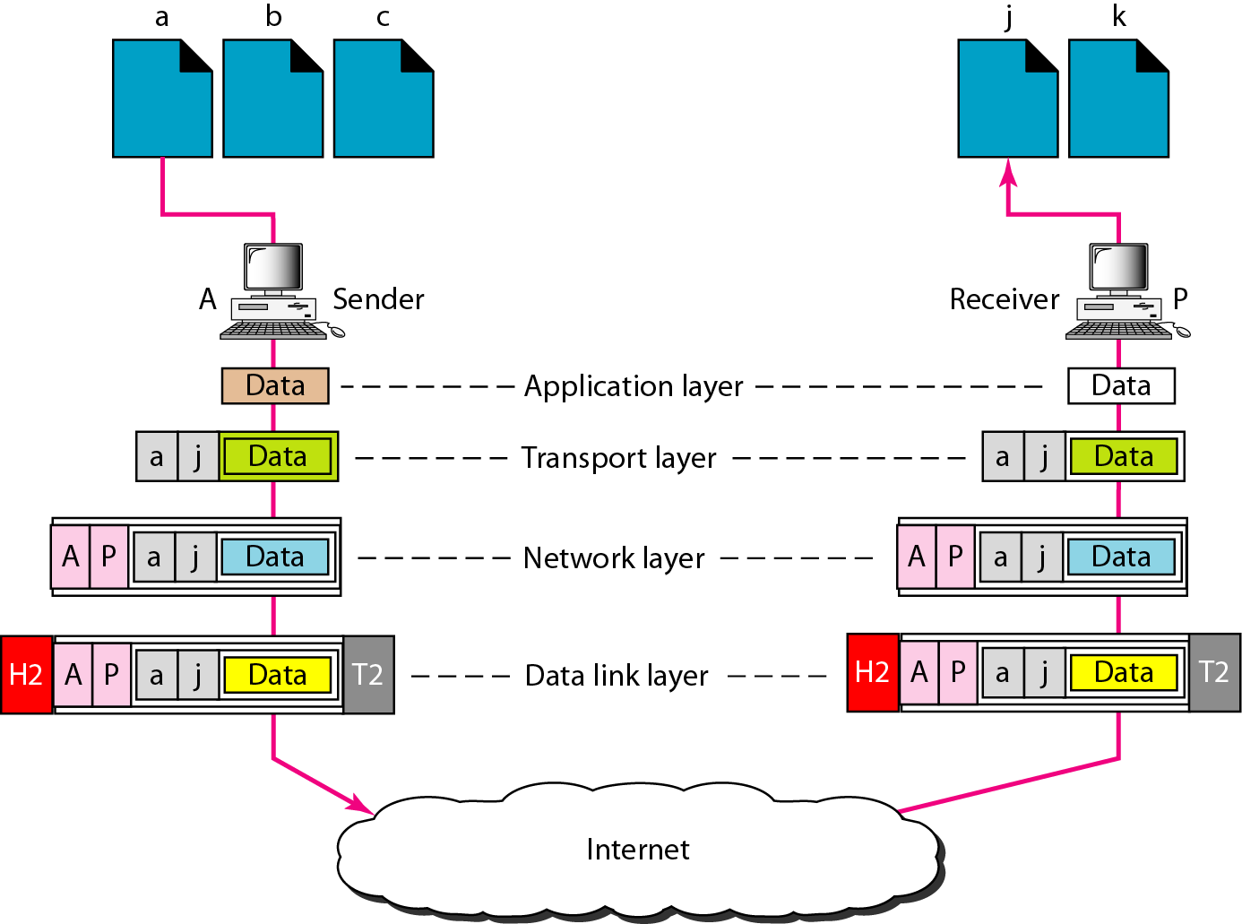
Figure 3 Port addresses

Slide 4

Note
The physical addresses will change from hop to hop,
but the logical addresses usually remain the same.

Slide 5
Example 5
A port address is a 16-bit address represented by one decimal number as shown.
753
A 16-bit port address represented as one single number.

Slide 6
Data Encapsulation In TCP/IP
At each layer in the TCP/IP protocol stack
Outgoing data is packaged and identified for delivery to the layer underneath
PDU – Packet Data Unit – the “envelop” information attached to a packet at a particular TCP/IP protocol
e.g. header and trailer
Header
PDU’s own particular opening component
Identifies the protocol in use, the sender and intended recipient
Trailer (or packet trailer)
Provides data integrity checks for the payload

Slide 7
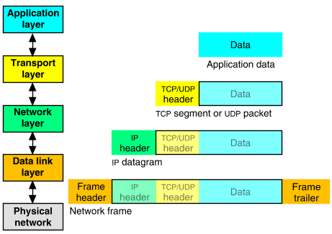
Packet Encapsulation (TCP/IP)
The data is sent down the protocol stack
Each layer adds to the data by prepending headers

Slide 8
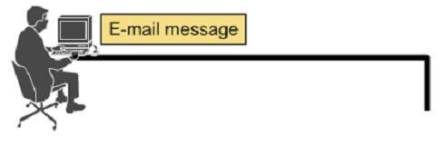





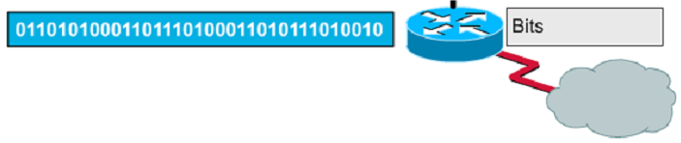
Encapsulation Example 6: E-mail

Slide 9
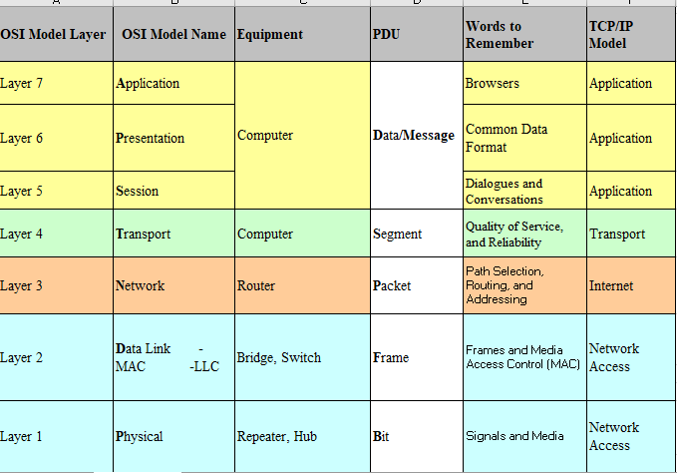
How the OSI and TCP/IP Models Relate in a Networking Environment

